Slide 1
THE NATION AT WAR
America: Past and Present
Chapter 24
Notes:
1

Slide 2
Assassination of Arch Duke Franz Ferdinand

Slide 3
Germany Marches through Belgium

Slide 4
Toward War
1914--War in Europe
Central Powers headed by Germany
Allied Powers headed by England, France
Wilson sympathizes with England, seeks U.S. neutrality
Notes:
9

Slide 5
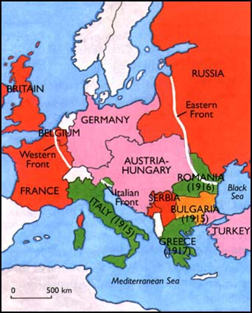
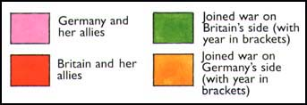

Slide 6
The Neutrality Policy
Progressives see war as wasteful, irrational
Suspicion that business seeks war for profit
Immigrants prefer U.S. neutrality
A long tradition of U.S. neutrality
Americans see little national stake in war
Notes:
10

Slide 7
Freedom of the Seas
England blockades Germany
U.S. ships to Germany seized
Wilson accepts English promise of reimbursement at war’s end
Notes:
11

Slide 8
The U-Boat Threat
German submarines violate international law by shooting without warning
August, 1915-- Lusitania sunk by U-Boat
April, 1916--Wilson issues ultimatum
Germany pledges to honor U.S. neutrality
Notes:
12

Slide 9
Sussex Pledge

Slide 10
Zimmerman Telegram

Slide 11
"He Kept Us Out of War"
1916--Wilson campaigns on record of neutrality
Republican Charles Evans Hughes campaigns on tougher line against Germany
Wilson wins close election
wins large labor, progressive vote
wins majority of women’s vote
Notes:
13

Slide 13
The Final Months of Peace
1917--Germany lifts restrictions on U-Boats
Wilson’s response
April 2, 1917--War declared on Germany
Notes:
14

Slide 14
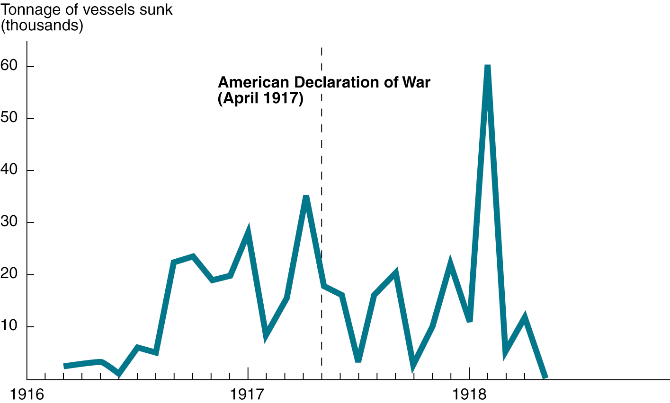
U.S. Losses to the German Submarine Campaign, 1916-1918
Notes:
14

Slide 15
Creel Committee

Slide 16
Mobilization
No U.S. contingency plans for war
200,000 troops at war’s beginning
Draft conscripts 2.8 million by war’s end
Notes:
15

Slide 17
European Alliances and Battlefronts, 1914-1917

Slide 18
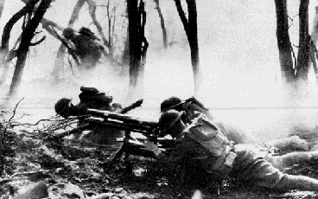

Slide 21
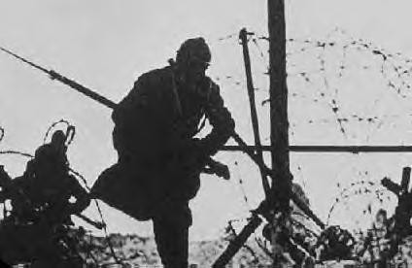

Slide 22
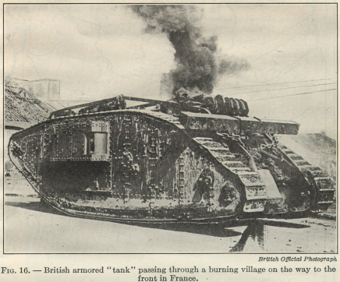

Slide 23
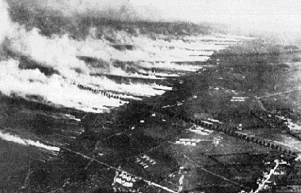

Slide 25
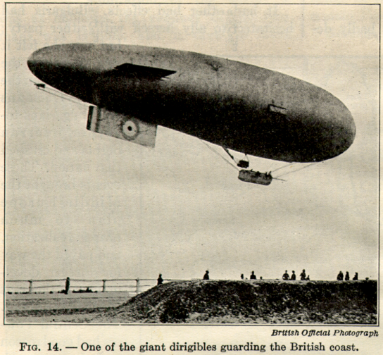

Slide 26
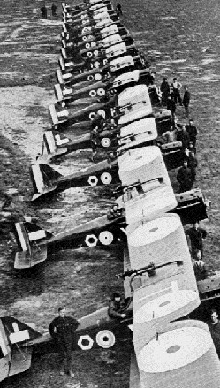

Slide 27
The Western Front: U.S. Participation, 1918

Slide 28
Secretary of State William Jennings Byran

Slide 29
The Conquest of Convictions
1918--Wilson uses popular anti-German rage to pass the Sedition Act
criticism of the war was penalized
dissenters imprisoned
Summer, 1918--anticommunism prompts deployment of U.S. troops to Russia
1918-1919--“Red Scare” results in domestic suppression of “radicals”
Notes:
17

Slide 30
A Bureaucratic War
Wartime agencies supervise production, distribution to maximize war effort
Government seizes some businesses to keep them running
Cooperation between government and business the norm
Business profits from wartime industry
Notes:
18

Slide 31
Herbert Hoover:

Slide 32
Labor in the War
Union membership swells
Labor shortage prompts
wage increase
entry of Mexican-Americans, women, African- Americans to war-related industrial work force
Bernard Baruch – War Industries Board
Notes:
19
Bernard Baruch appointed to head the War Industries Board in March,1918. a. Formed by Wilson late in war after significant political battles with Congress. i. Response to lack of centralized control due to political opposition ii. Military refused to cooperate with the civilian agency in purchasing supplies. -- Domestic war effort almost collapsed in December 1917. -- Wilson responded by taking firmer control under his emergency war powers. b. Aimed to control raw materials, production, prices & labor relations. c. Never had more than feeble formal powers; disbanded within days after the armistice. i. Most heavy equipment and munitions used by U.S. produced by Britain or France. ii. U.S. business’ desire for laissez faire and for a weak central gov’t strong. iii. Wilson’s defeat in 1918 Congressional elections forced him to abandon any plans for reconstruction or ordered demobilization. d. Set precedent for future gov’t-industry cooperation for 1920s and New Deal agencies of 1930s.

Slide 33
African American Migration Northward, 1910-1920

Slide 34
Labor in the War (2)
200,000 blacks serve in France
42,000 combat troops
Great Migration to northern factories
blacks must adjust industrial work pace
encounter Northern racism
1917-1919--Race riots in urban North
Wartime experience prompts new surge of black resistance
Notes:
20

Slide 35
Labor in the War (3)
Women in the work force
Armed Forces
Notes:
20

Slide 36
The Treaty of Versailles
Common concern about Bolshevik revolution
Wilson’s Fourteen points call for non-punitive settlement
England and France balk at Fourteen Points
Notes:
21

Slide 37
A Peace at Paris
Wilson fails to deflect Allied punishment of Germany in treaty
Treaty creates Wilson’s League of Nations
League's jurisdiction excludes member nations’ domestic affairs

Slide 39
Europe after The Treaty Versailles, 1919

Slide 40
Rejection in the Senate
Notes:
22

Slide 41
Rejection in the Senate (2)
Wilson hopes reelection will provide mandate for League of Nations
Landslide for Republican Warren Harding
Defeat of League of Nations brings defeat of Progressive spirit
Notes:
23

Slide 43
Postwar Disillusionment
To the next generation the war seemed futile, wasteful
The progressive spirit survived but without enthusiasm or broad based support
Americans welcomed Harding’s return to “normalcy”

Slide 44
Scars of War

